Slide 1
Economic Decision Making and the NFL Draft

Slide 2
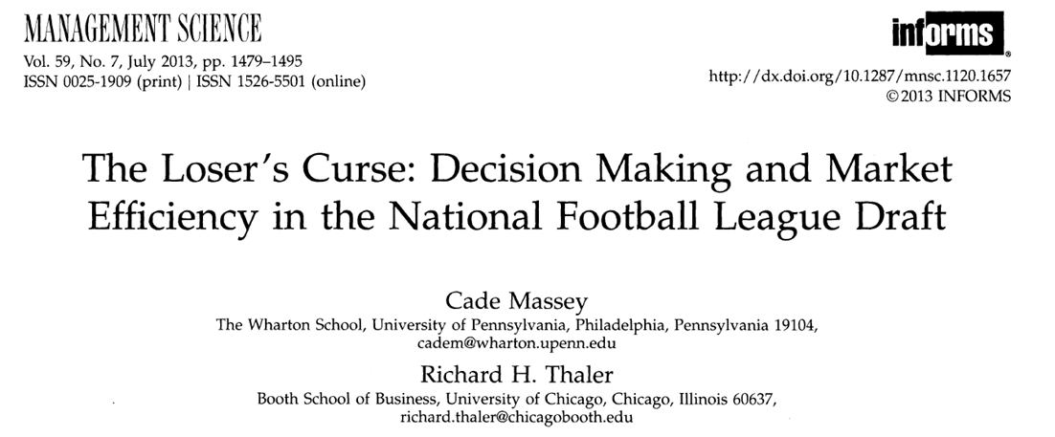

Slide 3
Market efficiency - suggests that at any given time, prices fully reflect all available information about a particular market. You are getting what you pay for.
Economic efficiency - efficient production decisions within firms and industries, efficient consumption decisions by individual consumers, and efficient distribution of consumer and producer goods across individual consumers and firms. Every decision yields the most benefit.

Slide 4
Slotted money - early picks must by rule get paid more
Salary cap - An NFL team can only spend a certain amount of money. Once that money is spent on one thing, it can’t be spent somewhere else.
-------------------
Thesis - The “loser’s curse” suggests that teams that pick early in the draft pay more money for less performance than do teams that pick later. This is because there is no correlation between draft order and performance.
Since losing teams pick earlier, they are burdened with a competitive disadvantage because of this.
Surplus value - Value minus cost
Thus, the NFL draft is not an “efficient” market

Slide 5
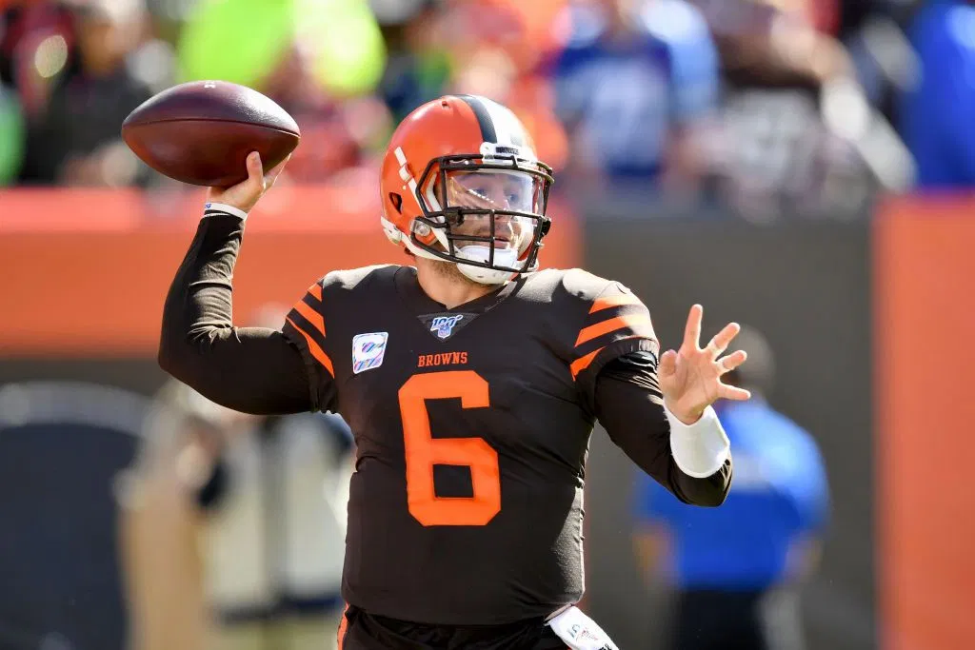
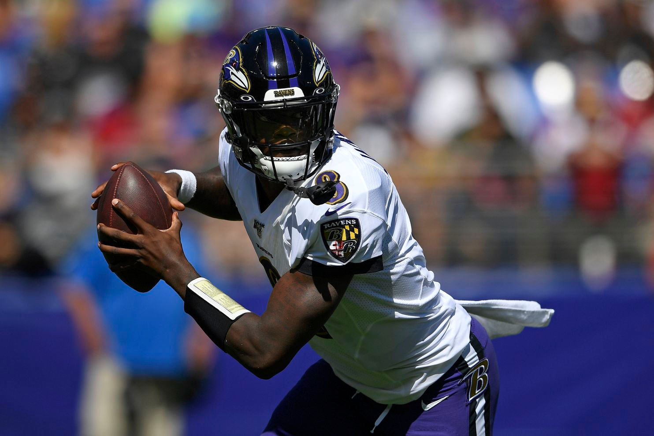
2018
Baker Mayfield (1) - 33 million guaranteed
Lamar Jackson (32) - 9 million guaranteed

Slide 6
Rational expectations - when making decisions, individual agents will base their decisions on the best information available. Rational expectations are the best guess for the future.
NFL teams clearly do this when preparing for the draft.

Slide 7
Because the NFL is not an efficient market, the draft violates the rule of rational expectations.

Slide 8
Overconfidence - individuals gain confidence as more information becomes available.
False consensus effect - the belief that other people are thinking the same way you are.
This causes teams to behave irrationally.
Irrationality - when people make choices and decisions that go against the assumption of utility-maximising behavior.

Slide 9
Implications for economic decision making

Slide 10
The consequences of the choices we make, particularly regarding opportunity cost (we all have a salary cap in life).

Slide 11
The world is more chaotic than economics would have us believe. Rational behavior can still create an inefficient market. Consider the work that NFL teams put into the draft.

Slide 12
Irrationality is often thought of as a symptom of decision making, but the NFL draft suggests that an economic structure, institution, or governing body may itself be irrational. This is a troubling idea for our future.

Slide 13
The fact that the NFL profits despite its flawed decision making process suggests lack of rationality among both leaders and consumers.

Slide 14
The benefits of irrationality. Sometimes it is better to think “outside the box”, to think creatively, and not do what everyone else does.

Slide 15
The NFL draft suggests a system that benefits winners and is biased against losers. In this way, it is a metaphor for our economy as a whole.

